Slide 1
Incom Development ASX “Trading Wheels”
This document is intended for the supervisor
Group of:
Shane McLaws (s3436830) Callum Pullyblank (s3378543)
Zac Williams (s3431670) Sonia Varghese (s3484881)

Slide 2
Links
Repository:
https://github.com/rmit-s3436830-shane-mclaws/capstoneASX
This repository is public, and can be viewed (but not edited) by anyone.
Trello (Kanban Board)]
https://trello.com/b/gHRBQ18v
Again, this board is public, but only team members may edit.

Slide 3
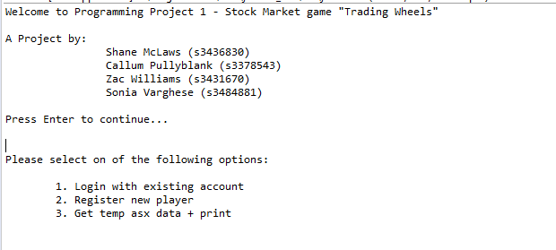
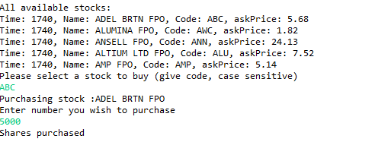
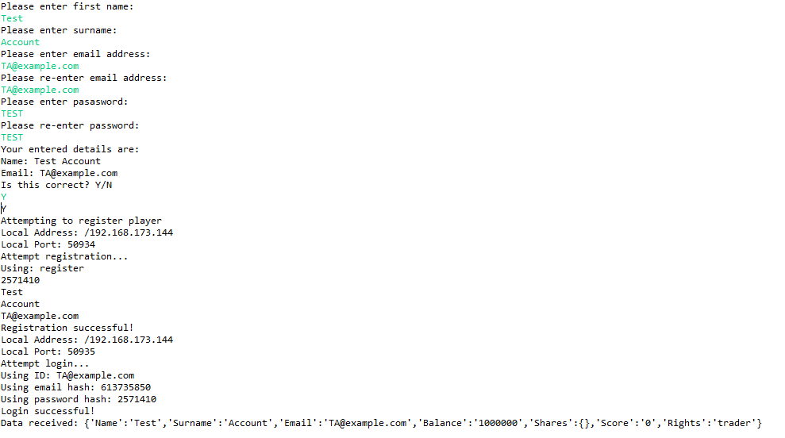
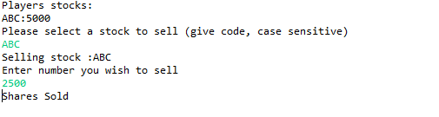

Screenshots of Text-based Program

Slide 4
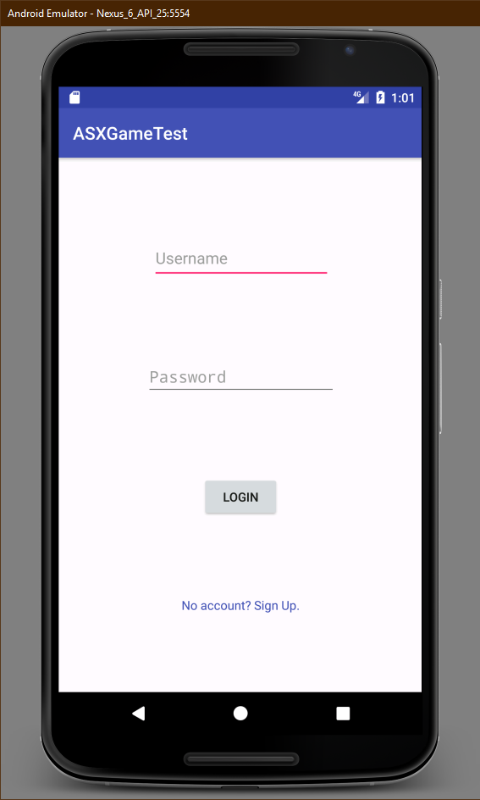
End-Of-Sprint Deliverables
Amazon Web Services Back-End
Pulls and stores data from Stock Exchange:
Company Code, Name & Data (Once per day)
Stock Info and Value per Company (Once per 20 minutes)
Storage for Account Functionality:
User Account Info
User Current Portfolio
User Transaction History
Text-Based Front-End
Online Functionality:
Pull Company & Stock Data from Server (Limited for basic development)
Register User
Login User
Buy Stocks
Sell Stocks
View Portfolio
Android Application & Interface
Basic Local Functionality:
Application Navigation

